Slide 1


Semantic Segmentation: Unet
Reporter. Jian.Yin,
Kangjian.Li, Jiuan.Liu
2019 / 12 / 19

Slide 2

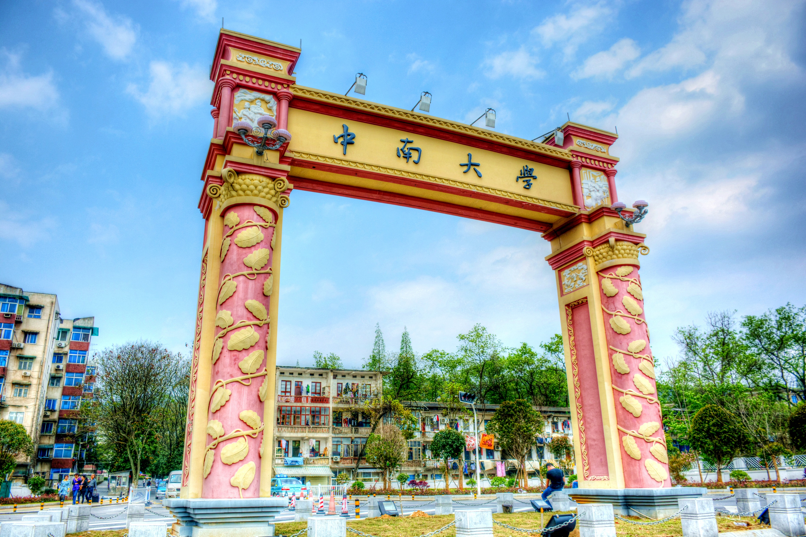
01
02
Background
Architecture
Contents.
03
Development
知行合一、经世致用
Central South University

Slide 3

01
Background
自强不息 厚德载物
知行合一、经世致用
Tsinghua University of China
Central South University

Slide 4

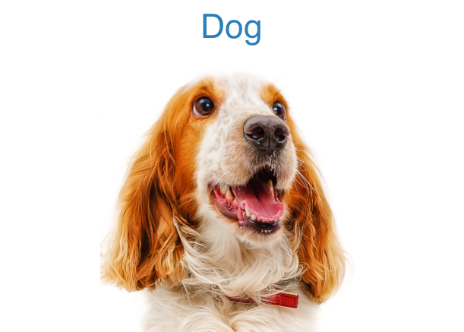
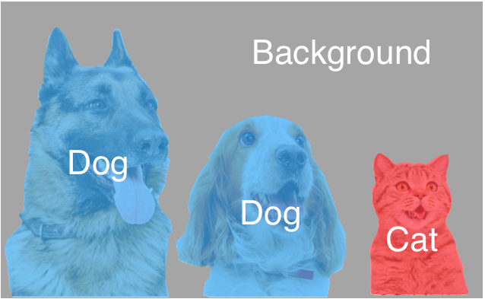
Semantic segmentation
1.1
Image Classification
Semantic Segmentation
知行合一、经世致用
自强不息 厚德载物
Central South University

Slide 5
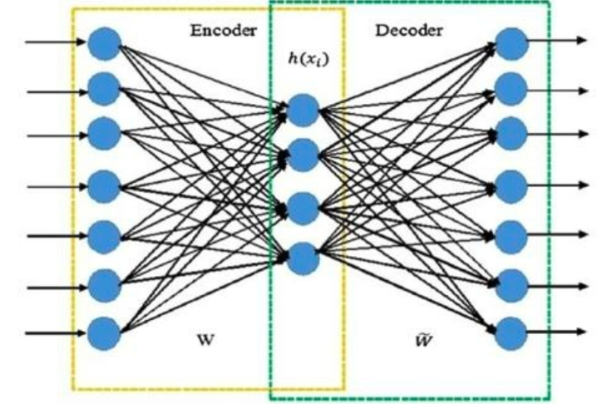
AutoEncoder
1.2
AutoEncoder idea is to map information from a feature space to a new feature space.
The input of the sample is also the ground true of the network.
知行合一、经世致用
自强不息 厚德载物
Central South University

Slide 6
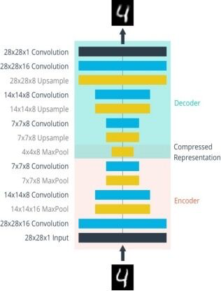
AutoEncoder
1.2
The network between encoder and decoder can be diverse.
知行合一、经世致用
自强不息 厚德载物
Central South University

Slide 7
Upsampling
1.2
Reshape
知行合一、经世致用
自强不息 厚德载物
Central South University

Slide 8


Deconvolution
1.3
Convolution
Deconvolution
知行合一、经世致用
自强不息 厚德载物
Central South University

Slide 9
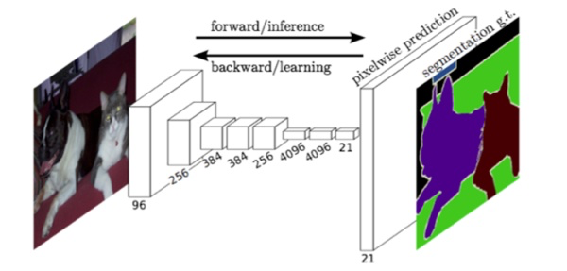
Fully Convolution Network
1.4
One-step deconvolution
知行合一、经世致用
自强不息 厚德载物
Central South University

Slide 10
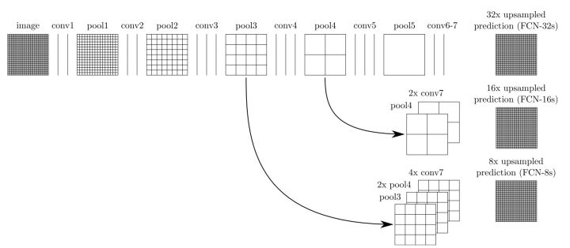
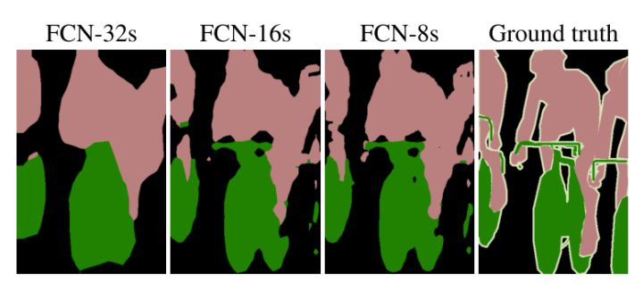
Fully Convolution Network
1.4
Feature fusion
知行合一、经世致用
自强不息 厚德载物
Central South University

Slide 11
Fully Convolution Network
1.4
Advantage：There are not fully connected layer, can accept input images of any size.
Disadvantage：The results are still not fine enough.
知行合一、经世致用
自强不息 厚德载物
Central South University

Slide 12
02
Architecture
自强不息 厚德载物
知行合一、经世致用
Tsinghua University of China
Central South University

Slide 13

U net
2.1
Expanding path:
Contracting path
知行合一、经世致用
自强不息 厚德载物
Central South University

Slide 14
U net
2.1
Contracting path:
1.Increase the robustness to some small disturbances of the input image
2.Reduce the risk of over fitting
3.Reduce the amount of computation
4.Increase the size of receptive field
Expanding path:
1.Restore image to original size
2.Guide encoder to select important features
知行合一、经世致用
自强不息 厚德载物
Central South University

Slide 15
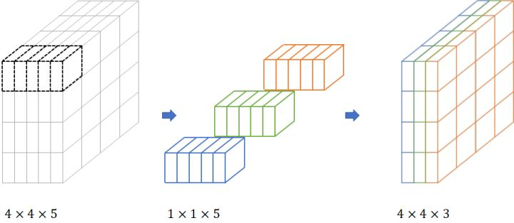
1x1 convolution layer
2.2
1x1 convolutiona layer：
Control dimension change
Reduce the amount of calculation and the consumption of storage
知行合一、经世致用
自强不息 厚德载物
Central South University

Slide 16
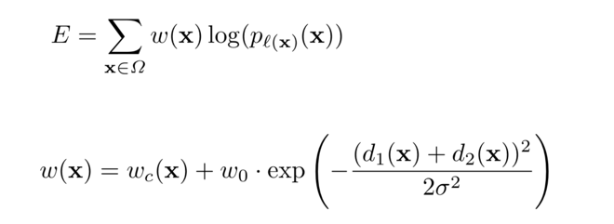
Unet Loss function
2.3
pre-compute the weight map for each ground truth segmentation to com- pensate the different frequency of pixels from a certain class in the training data set
知行合一、经世致用
自强不息 厚德载物
Central South University

Slide 17
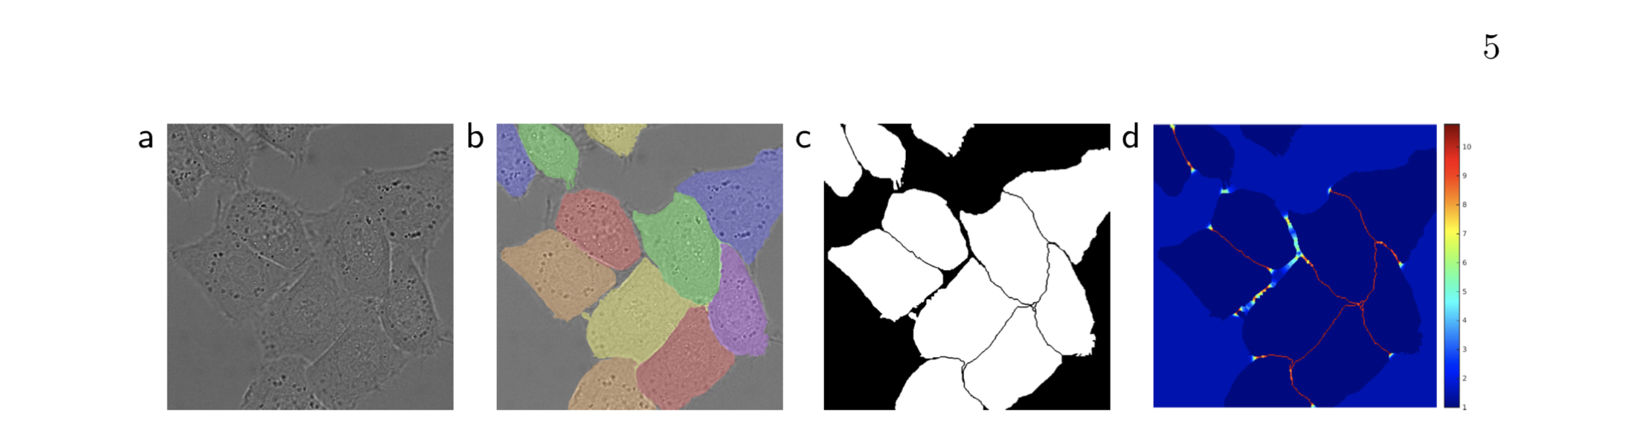
Unet Loss function
2.3
知行合一、经世致用
自强不息 厚德载物
Central South University

Slide 18
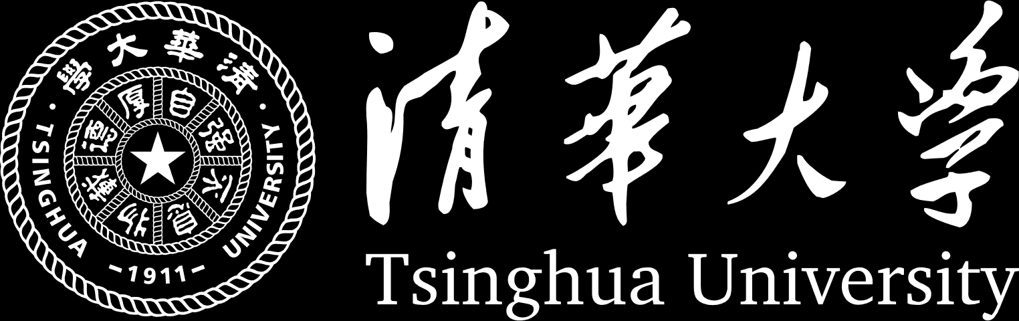
03
Development
知行合一、经世致用
自强不息 厚德载物
Central South University

Slide 19
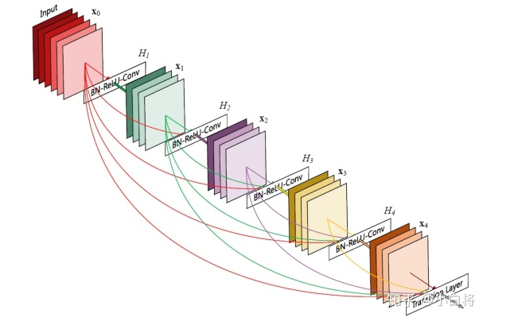
Introduction
3.1
What is the DenseNet ?
知行合一、经世致用
自强不息 厚德载物
Tsinghua University of China
Central South University

Slide 20
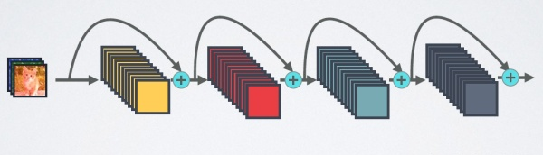
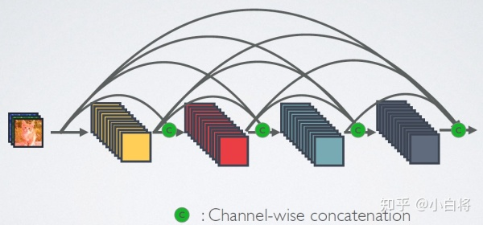
DenseNet: better CNN model than ResNet
3.2
Figure 1 short circuit connection mechanism of ResNet network
The difference between ResNet and DenseNet
Figure 2 DenseNet network's dense connection mechanism
知行合一、经世致用
自强不息 厚德载物
Tsinghua University of China
Central South University

Slide 21
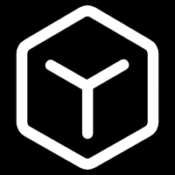
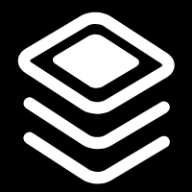
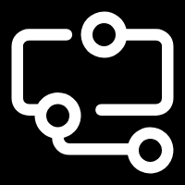
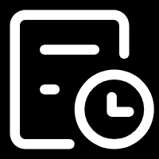
The advantage of DenseNet
3.3
Save parameters
Anti-overfitting
Stronger generalization performance
Save calculation
知行合一、经世致用
自强不息 厚德载物
自强不息 厚德载物
Tsinghua University of China
Central South University

Slide 22
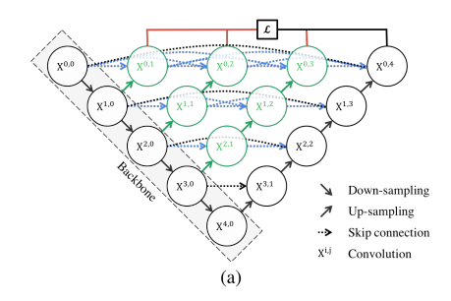
Unet++
3.4
Unet forms UNet++ based on the idea of DenseNet
知行合一、经世致用
自强不息 厚德载物
Tsinghua University of China
Central South University

Slide 23
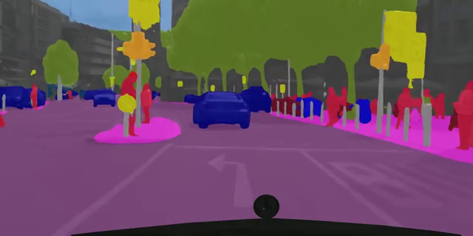
Application
3.5
Full-Resolution Residual Networks for Semantic Image Segmentation Street Scenes
知行合一、经世致用
自强不息 厚德载物
Tsinghua University of China
Central South University

Slide 24
Thanks for all

